Slide 1
Automated Briefings with Dash

Slide 2
Agenda
What’s Plotly Dash?
Case Study – ICB Briefings
Building a demo app

Slide 3
Plotly Dash

Slide 4
What’s Plotly Dash
Data visualisation / Dashboarding tool built on top of Flask
Key elements – App Layout & Callbacks
Other tools are available (Rmd, Quarto) and your mileage my vary
Notes:
Dash apps are composed of two parts.
The first part is the "layout", which describes what the app looks like
The layout is composed of a tree of "components" such as html.Div and dcc.Graph.
The Dash HTML Components module (dash.html)
has a component for every HTML tag. The html.H1(children='Hello Dash') component generates a <h1>Hello Dash</h1> HTML element in your app.
Not all components are pure HTML. The Dash Core Components module (dash.dcc) contains higher-level components that are interactive and are generated with JavaScript, HTML, and CSS through the React.js library.
Each component is described entirely through keyword attributes. Dash is declarative: you will primarily describe your app through these attributes.
Dash includes "hot-reloading", this feature es is activated by default when you run your app withapp.run_server(debug=True). This means that Dash will automatically refresh your browser when you make a change in your code.
You can also include things like Markdown and Graphs
callback functions: functions that are automatically called by Dash whenever an input component's property changes, in order to update some property in another component (the output).
It's sort of like programming with Microsoft Excel: whenever a cell changes (the input), all the cells that depend on that cell (the outputs) will get updated automatically. This is called "Reactive Programming" because the outputs react to changes in the inputs automatically.

Slide 5
Case Study

Slide 6
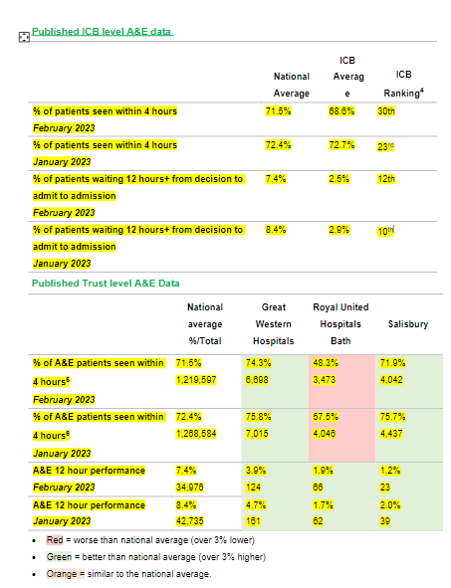
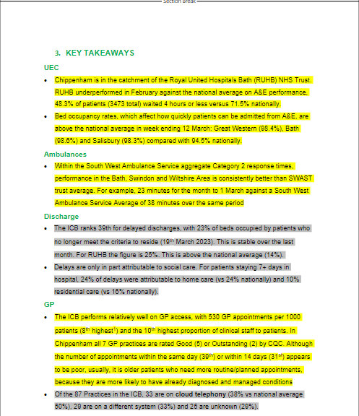
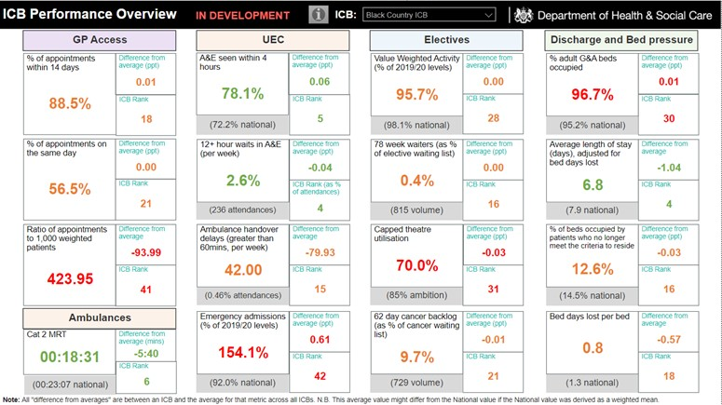
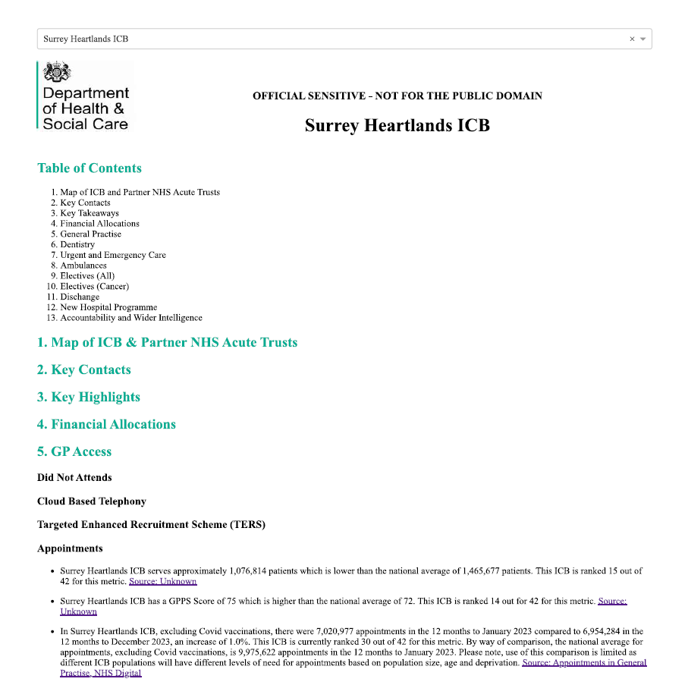
ICB Briefings
Regular meetings between SofS and MPs / CEO’s of ICBs
Time consuming and labour intensive to produce the briefing pack often with short deadlines
Reproducible Analytical Pipelines
Dash App
Notes:
The ICB Dashboard was developed to support Ministers in performance discussions with Integrated Care Boards (ICBs).
It is refreshed on a monthly basis
The scope comprises GPs, Ambulances, Urgent and Emergency Care (UEC), Electives, Dentistry, and Discharge/Bed Pressures
They wish to see the current state, plus trends over time and

Slide 7
Why Reproducible Analytical Pipelines (RAP)?
“Reproducible Analytical Pipelines (RAPs) are automated statistical and analytical processes. They incorporate elements of software engineering best practice to ensure that the pipelines are reproducible, auditable, efficient, and high quality. RAPs increase the efficiency of statistical and analytical processes, delivering value. Reproducibility and auditability increase trust in the statistics. The pipelines are easier to quality assure than manual processes, leading to higher quality solutions.”
The Civil Service Analysis Function
Specifically, we are looking for RAP to deliver the following:
Accuracy – implementing analysis and data manipulation in code means it can be tested, peer reviewed and audited so that we can be explicit in how analysis in the DataHub has been derived. Ministers and others ask these questions! It also dramatically reduces the risk of human error skewing our data and results.
Efficiency – Analysis in the DataHub is being used to respond to urgent Ministerial and other questions. It also supports briefings given to Ministers, often at short notice. Removing manual steps from the current process will reduce the time taken to produce this analysis and also ensure the process is predictable - the same steps, every time.

Slide 8
DHSC RAP tools
Contact Mat Katz for more details
GitHub Project Template:
Provides best practice guidance in README
Standard directory structure (follows that of R package)
Logging functions
Dependency management via DESCRIPTION file and custom functions
DHSC Data Store package
Demonstrate best practice and provide “off-the-shelf” access to common data sources
Foundry, GOV.UK files, ONS

Slide 9
The App
Notes:
Toggling between ICBs changes the content and the charts
You can add image files
You can upload datasets which will be rendered as tables
You can add markdown which will be rendered inline.
Draw distinctions between this and Rstudio / RMD – this is a ‘no code’ option which is ideal for policy people.

Slide 10
Building an App

